Slide 1
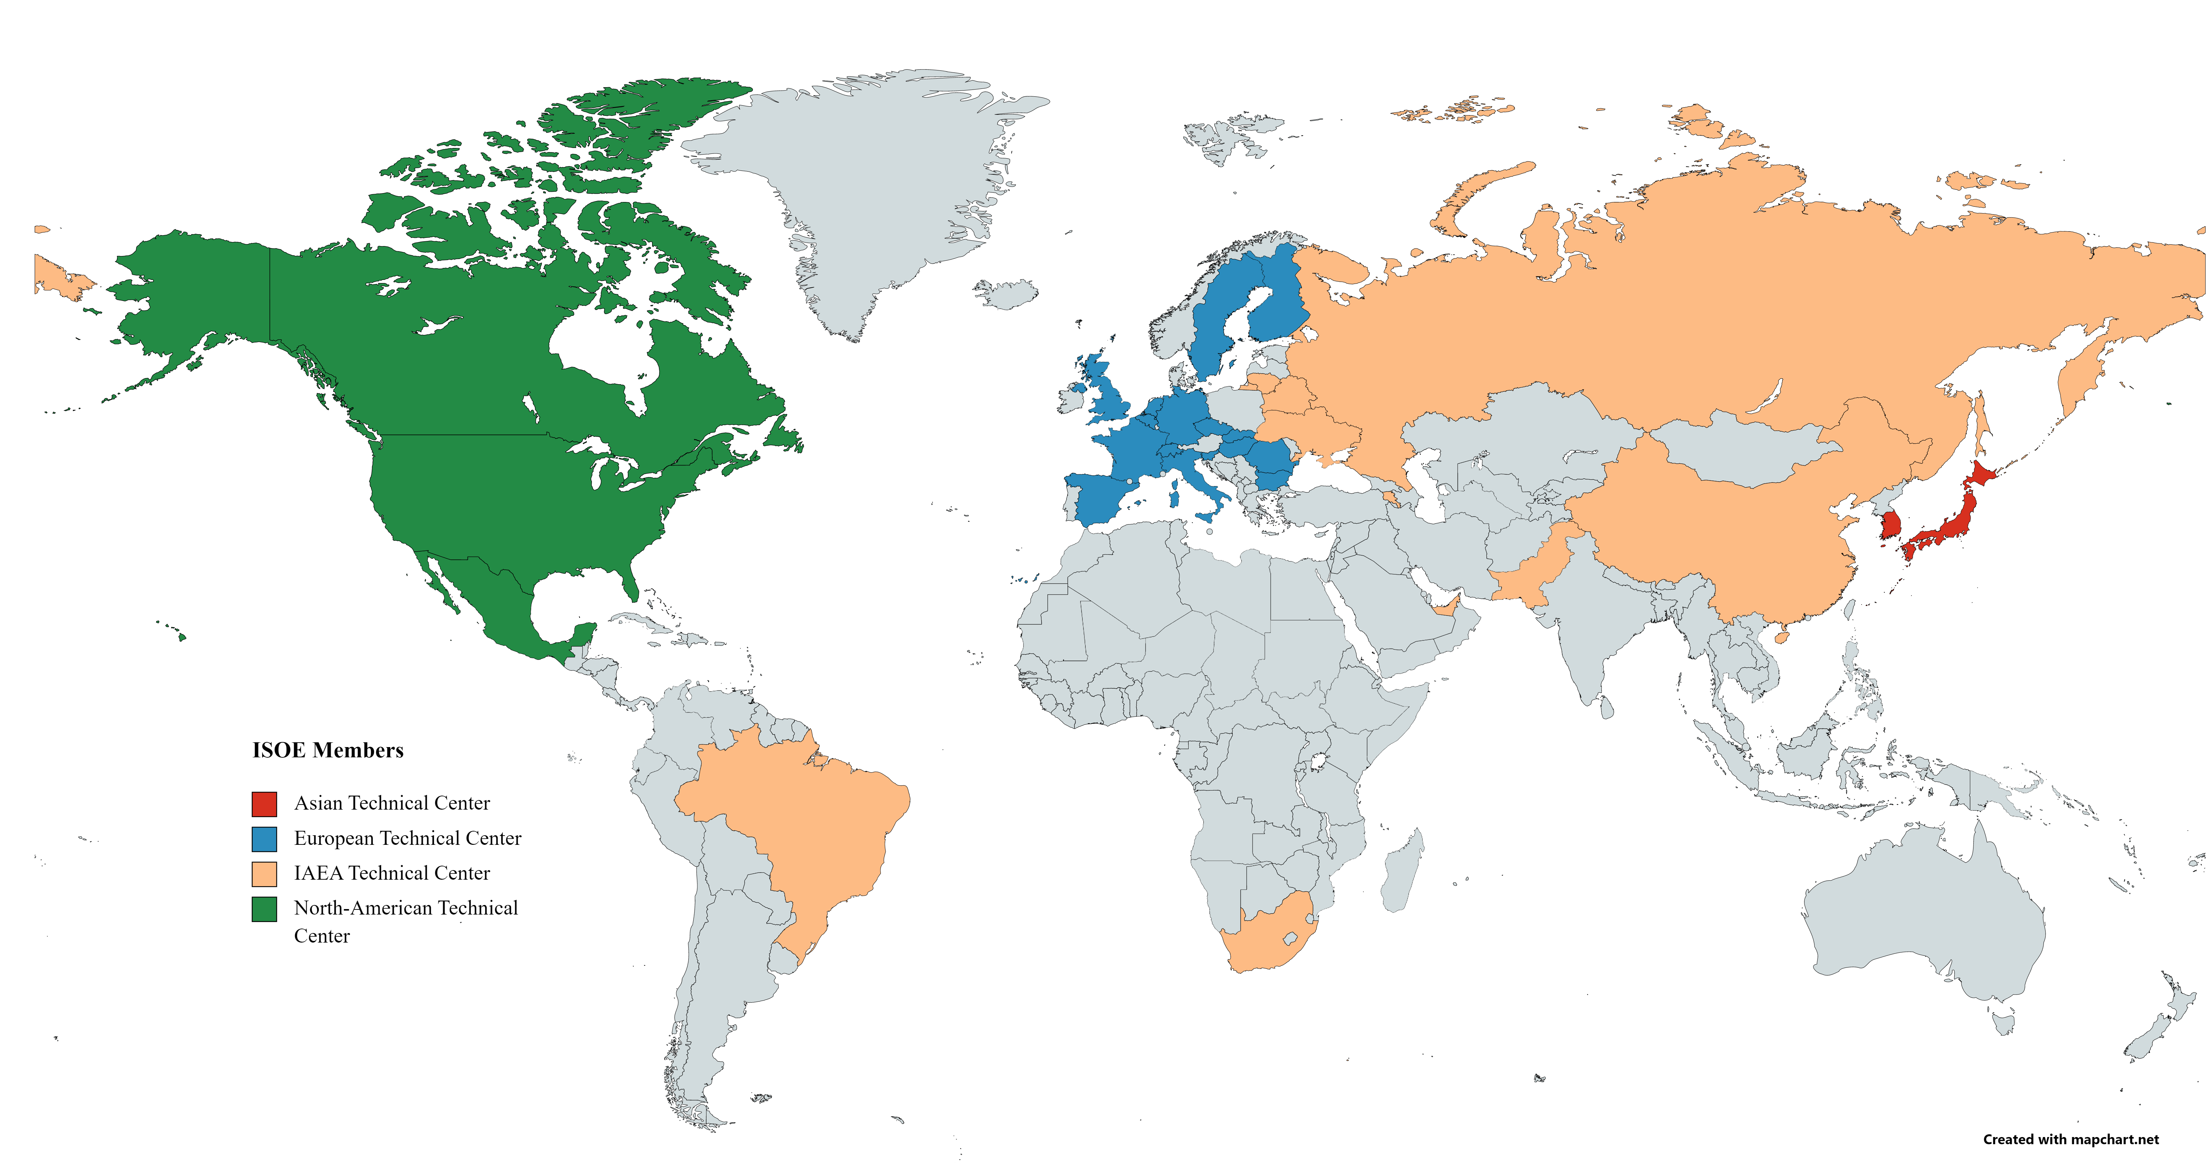
ISOE - Information System on Occupational Exposure
General Presentation
February 2024

Slide 2
Presentation Layout
ISOE Objective and Membership
ISOE Organisation
ISOE Working Groups
ISOE Products and Benefits
ISOE Website
ISOE Database

Slide 3
ISOE: Objectives and Membership
Created in 1992
A network of RP professionals from nuclear licensees and national regulatory authorities worldwide
Objective: to improve the management of occupational exposure at nuclear power plants by exchanging broad and regularly updated information, data and experience on methods to optimise occupational radiological protection
As of December 2023, the ISOE programme included:
  77 Nuclear Licensees in 31 countries
  27 Regulatory Authorities in 25 countries
  Dose data from 354 operating units; 71 shutdown units; 15 units under construction and/or commissioning
The ISOE is jointly sponsored by the:
  OECD Nuclear Energy Agency (NEA), and
  International Atomic Energy Agency (IAEA).
ISOE Objectives
ISOE Organisation
ISOE WG
ISOE Products
ISOE Website
ISOE Database

Slide 4
ISOE Organisation
The ISOE operates in a decentralised manner.
  Management Board (MB) composed of representatives from licensees and regulatory authorities from all participating countries takes decisions and provides overall direction (1 meeting /year)
  Bureau, elected by the MB, guides ISOE and Secretariat work between MB meetings
  (2 meetings/year)
  Both are supported by the joint NEA/IAEA Secretariat
Four ISOE Technical centres (Asia, Europe, IAEA and North America) serve the programme’s day-to-day technical operations and are contact points for the transfer of information from and to participant countries
A National co-ordinator in each country provides a link between ISOE participants and the ISOE programme
Specialised working groups, mandated by the Management Board, are created on an as-needed basis to support the goals of the ISOE on specific topics
ISOE Objectives
ISOE Organisation
ISOE WG
ISOE Products
ISOE Website
ISOE Database

Slide 5
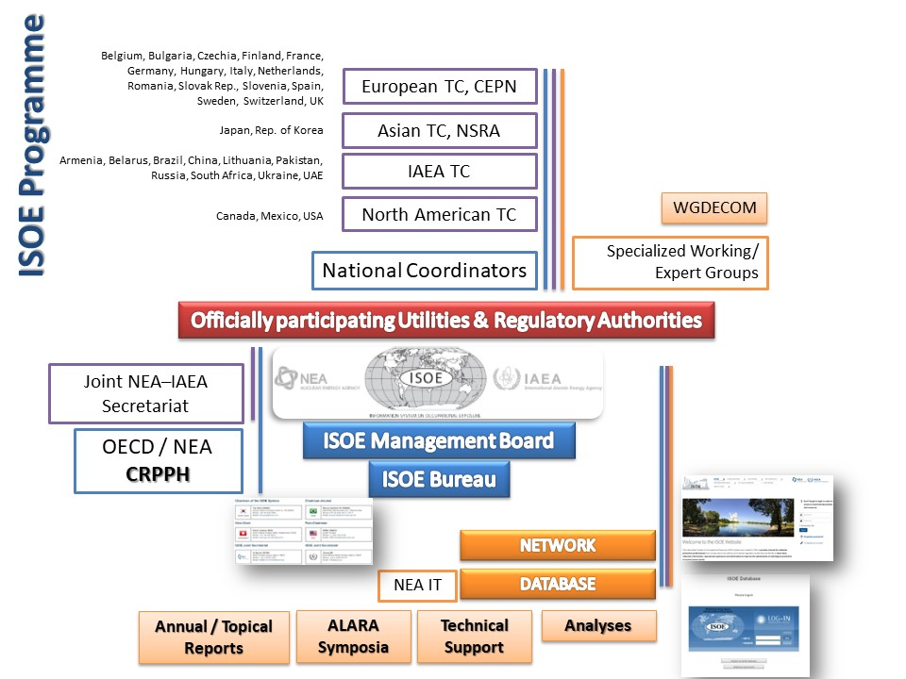
ISOE Organisation
ISOE Objectives
ISOE Organisation
ISOE WG
ISOE Products
ISOE Website
ISOE Database

Slide 6
ISOE Organisation
ISOE Objectives
ISOE Organisation
ISOE WG
ISOE Products
ISOE Website
ISOE Database

Slide 7
How to Join ISOE
ISOE Objectives
ISOE is open to Nuclear Licensees and National Regulatory Authorities
In order to participate to the ISOE Programme, eligible parties must notify the ISOE Secretariat of their acceptance of the ISOE Terms and Conditions, available on the ISOE Network Website: www.isoe-network.net
A specific form to join the System is available on the ISOE Network Website
Members are affiliated to a Technical Center, according to their countries
ISOE Organisation
ISOE WG
ISOE Products
ISOE Website
ISOE Database

Slide 8
ISOE Working Group
ISOE Objectives
WGDECOM - Working Group on Radiological Aspects of Decommissioning Activities in Nuclear Power Plants
  Benchmarking visits (1 to 2 per year) in NPPs under decommissioning to collect feedback regarding RP issues related to decommissioning activities
  Network of RPMs, or other specialists in decommissioning
  Membership: as of November 2023, WGDECOM consists of 19 members from 12 countries from NPPs in decommissioning or in preparation for decommissioning
ISOE Organisation
ISOE WG
ISOE Products
ISOE Website
ISOE Database

Slide 9
ISOE Products and Benefits (1)
ISOE Objectives
A global Network of RP professionals from nuclear licensees and national regulatory authorities
The world’s largest database on occupational exposure from nuclear power plants. The NEA provides IT support to further develop and maintain an internet‐based system for the ISOE
ISOE Website: Access to the ISOE database, products, resources and online user fora
Detailed studies and analyses on current issues in operational RP and dose trends
ISOE Organisation
ISOE WG
ISOE Products
ISOE Website
ISOE Database

Slide 10
ISOE Products and Benefits (2)
ISOE Objectives
Reports:
  Annual ISOE reports: annual status of ISOE programme, occupational exposure trends, principal events in participating countries
  Annual country reports: annual dose information and principal events in participating countries
  Topical reports: working groups reports
Symposia:
  Regional and international ALARA symposia organised yearly by Technical centres
  Radiological protection manager meetings
  Regulatory body representative meetings
Benchmarking visits allow ISOE members to share their experience and good RP practices
ISOE Organisation
ISOE WG
ISOE Products
ISOE Website
ISOE Database

Slide 11
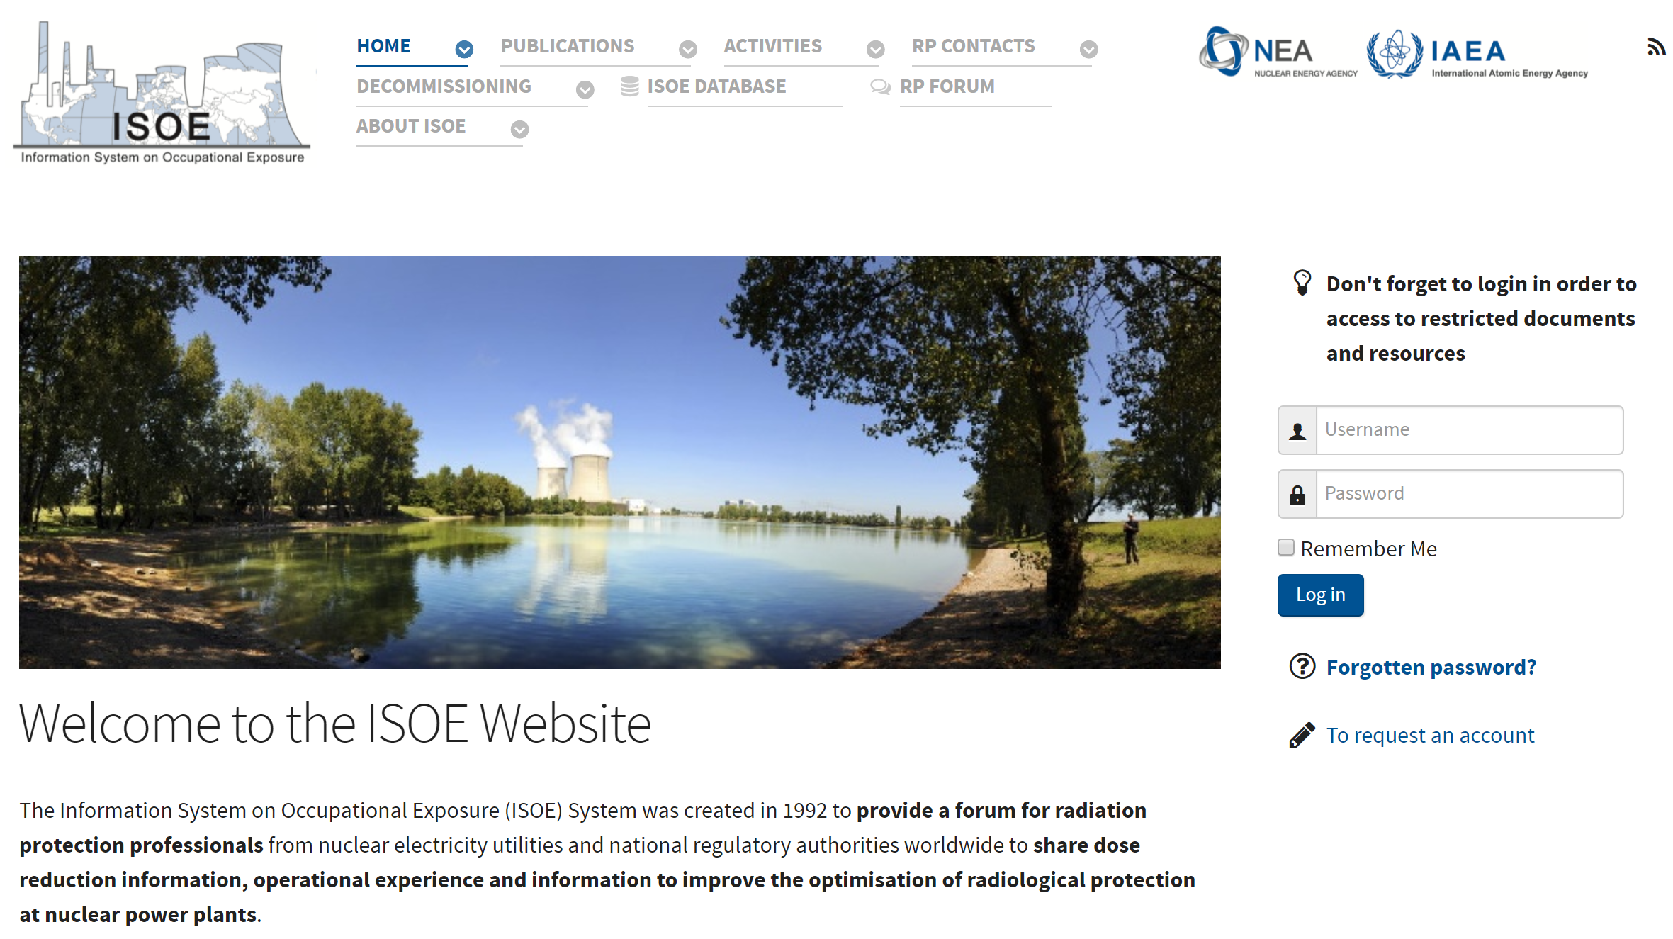
The ISOE Website (www.isoe-network.net)
ISOE Objectives
ISOE Organisation
ISOE WG
ISOE Products
ISOE Website
ISOE Database

Slide 12
Examples of documents available on ISOE Website
ISOE Objectives
Proceedings:
  Symposia classified by year or by theme
  Workshops (Reactor cavity decon., EGSAM)
  Topical sessions
Annual country reports
Information sheets
Working groups reports
Benchmarking reports (public or restricted)
RP Experience reports (public or restricted)
Plant information (SGR, RVHR, Zn injection) (restricted)
OpEx reports (restricted)
Thematic documents (Source Term management, Severe accident management, Reactor cavity decontamination) (restricted)
ISOE Organisation
ISOE WG
ISOE Products
ISOE Website
ISOE Database

Slide 13
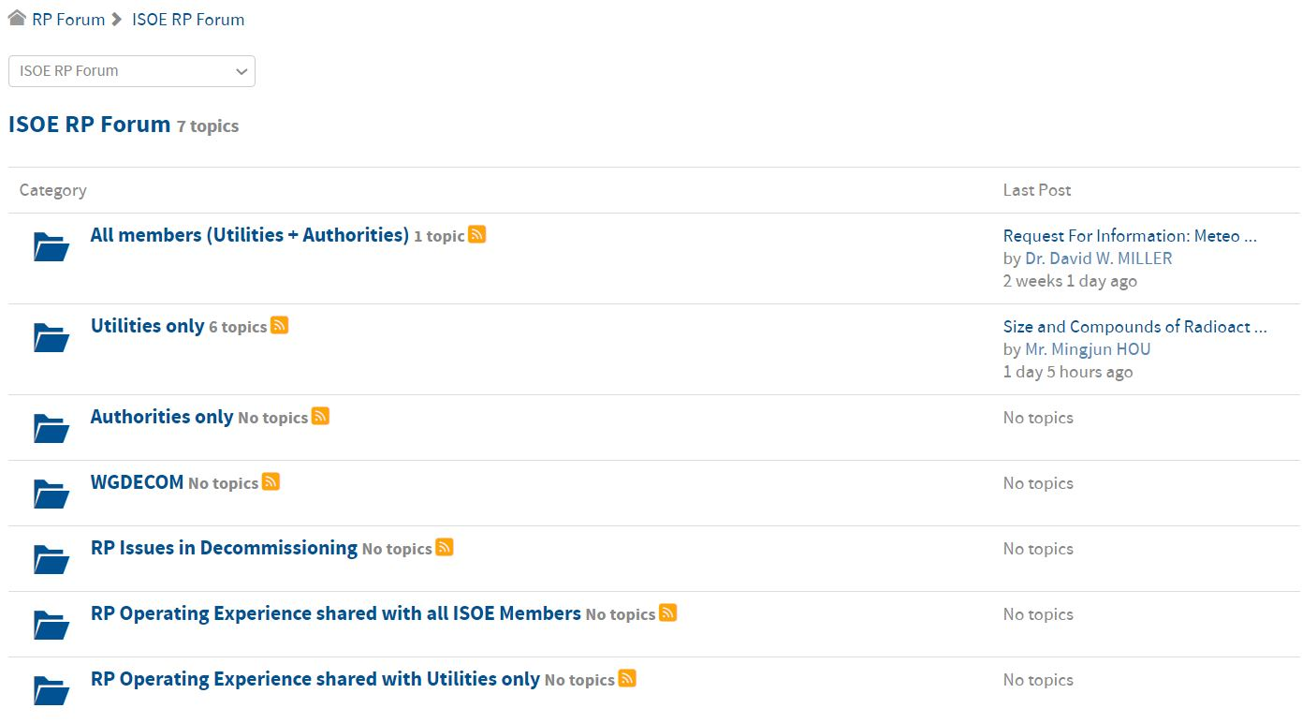
ISOE RP Forum (1)
ISOE Objectives
ISOE Organisation
ISOE WG
ISOE Products
ISOE Website
ISOE Database

Slide 14
ISOE RP Forum (2)
ISOE Objectives
General fora to exchange about RP issues dedicated to:
  All members
  Utilities only
  Authorities only
WGDECOM forum restricted to WGDECOM members to exchange about WG issues
RP Issues in Decommissioning for all ISOE members
Fora to exchange information about events occurring on ISOE members installations:
  RP Operating Experiences shared with all ISOE members
  RP Operating Experiences shared with Utilities only
ISOE Organisation
ISOE WG
ISOE Products
ISOE Website
ISOE Database

Slide 15
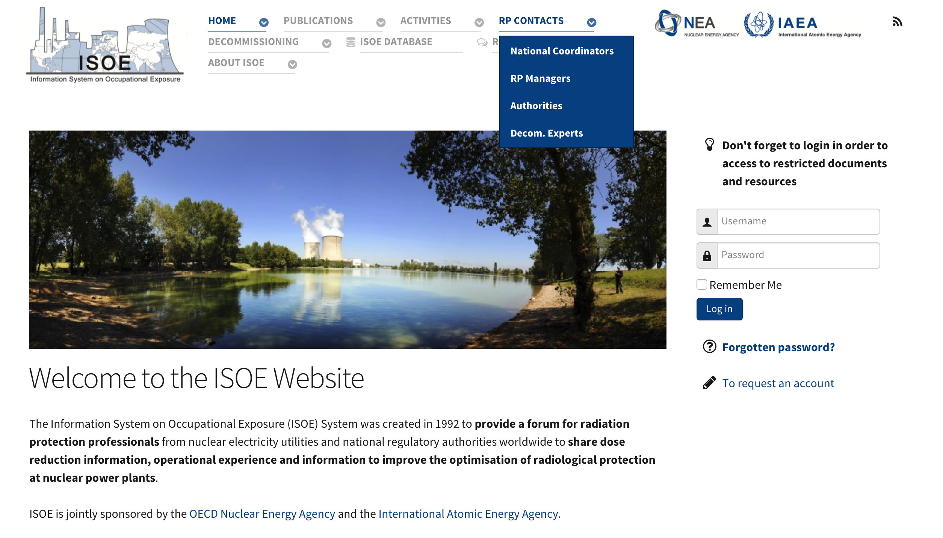
ISOE Contacts
ISOE Objectives
ISOE Organisation
ISOE WG
ISOE Products
ISOE Website
ISOE Database

Slide 16
Use of ISOE Contacts
ISOE Objectives
Organisation of benchmarking visits – examples with reports available on ISOE website:
  EDF visit at Exelon corporate
  Comanche Peak visit at Doel NPP
  Japanese delegation visits to US plants (Fermi, Limerick, Susquehanna, Dresden, etc.)
Sending of requests directly to National coordinators, Authorities or RPMs:
  Example: Survey on the values and uses of the monetary value of the man.Sievert realised in 2017
  Results published in ISOE ETC Information Sheet No. 61
ISOE Organisation
ISOE WG
ISOE Products
ISOE Website
ISOE Database

Slide 17
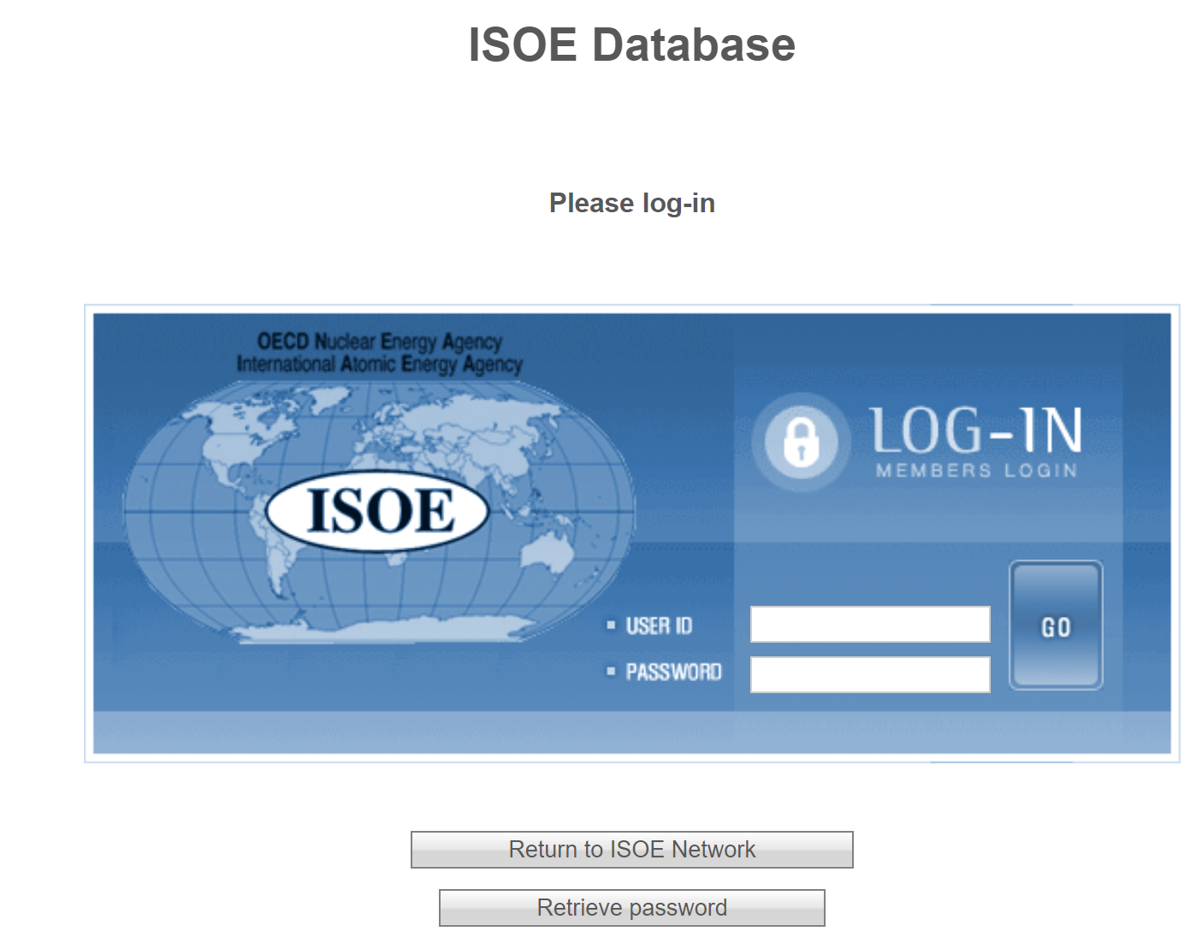
Access to the ISOE Database
ISOE Objectives
ISOE Organisation
ISOE WG
ISOE Products
ISOE Website
ISOE Database

Slide 18
Content of the ISOE Database
ISOE Objectives
Occupational dosimetric information from commercial NPPs in operation
or in some stage of decommissioning, including:
  annual collective dose for normal operation
  maintenance/refueling outage dose
  forced outage dose
  annual collective dose for certain tasks and worker categories
  dose rates
ISOE Organisation
ISOE WG
ISOE Products
ISOE Website
ISOE Database

Slide 19
Database Analyses and Benchmarking
ISOE Objectives
Data available in database provides a solid basis for analyses on issues in operational RP such as dose trends, doses related to certain jobs and tasks, identification of good performance, etc.
Several ways to use the database:
  MADRAS analysis package : main trends in occupational exposure
  Direct access to ISOE questionnaires, including contact information and complementary data
  Direct access to all the data available using the data extraction module
ISOE Organisation
ISOE WG
ISOE Products
ISOE Website
ISOE Database

Slide 20
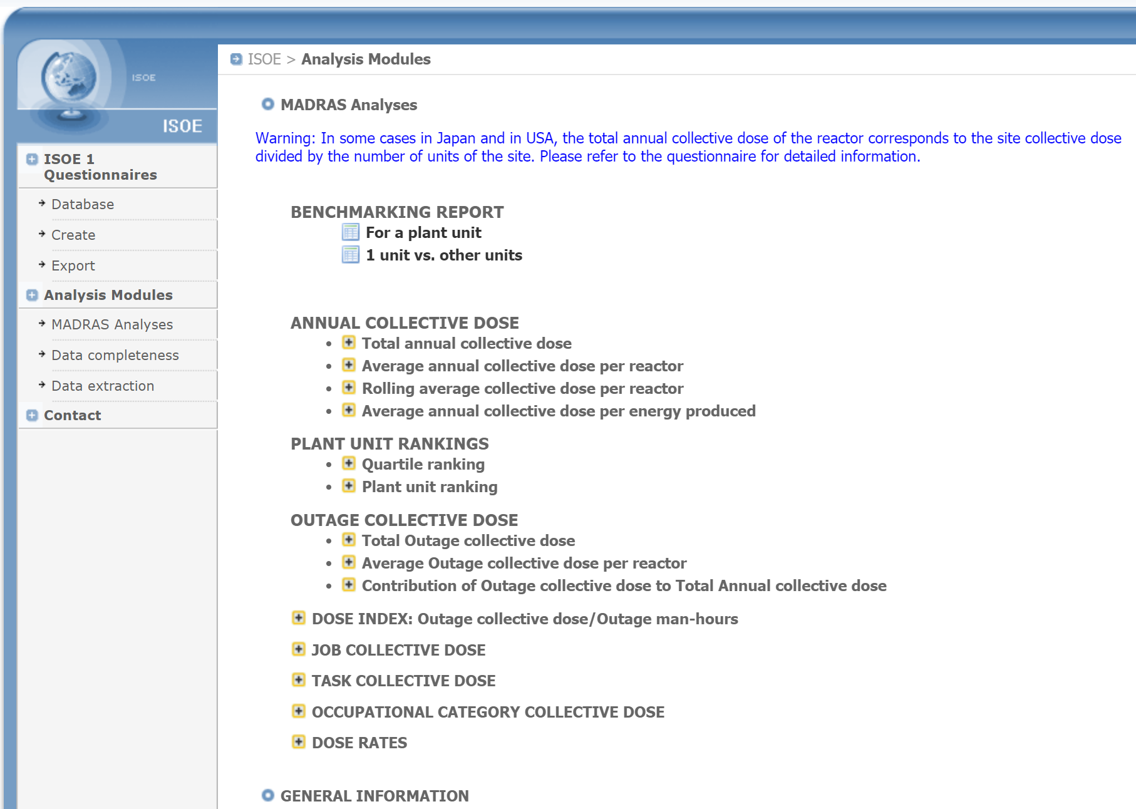
MADRAS Data Analyses
ISOE Objectives
ISOE Organisation
ISOE WG
ISOE Products
ISOE Website
ISOE Database

Slide 21
MADRAS Data Analyses
ISOE Objectives
A set of pre-defined data queries to facilitate analysis of main trends in occupational exposure, benchmarking between plants, sister units, etc.
  Benchmarking at unit level
  Annual collective dose
  Outage collective dose
  Plant unit ranking
  Total annual collective dose vs. number of operating reactors
  Total annual collective dose by reactor age
  Job collective dose
  Occupational category collective dose
  Dose rates
ISOE Organisation
ISOE WG
ISOE Products
ISOE Website
ISOE Database

Slide 22
Using ISOE Database as a Benchmarking Tool
ISOE Objectives
Analyses at country or regional level:
  Trends in Annual average collective dose per reactor
  Annual total collective dose
  Between countries or regions:
  by country/region for a given reactor type, or all reactors,
  including rolling average over several years
  Within a country: Specific unit versus another unit or by type of reactor
Analyses at utility level:
  Specific utility versus other utilities
  Specific utility by reactor type
Analyses at unit level
  Specific unit versus another unit / sister group / reactor type
  Benchmarking at the job and task level
ISOE Organisation
ISOE WG
ISOE Products
ISOE Website
ISOE Database

Slide 23
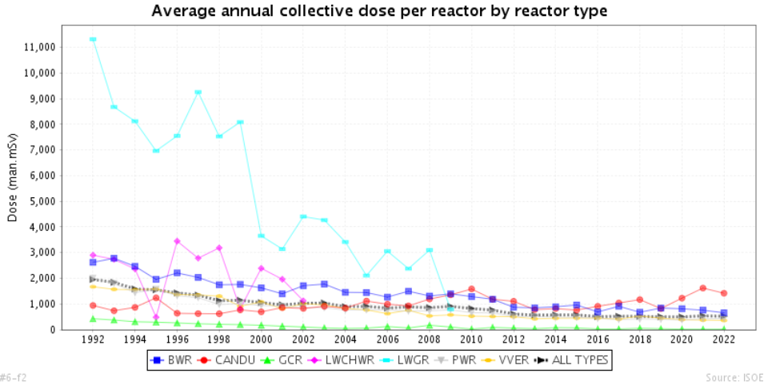
Collective Dose Trends by Reactor Type
ISOE Objectives
ISOE Organisation
ISOE WG
ISOE Products
ISOE Website
ISOE Database

Slide 24
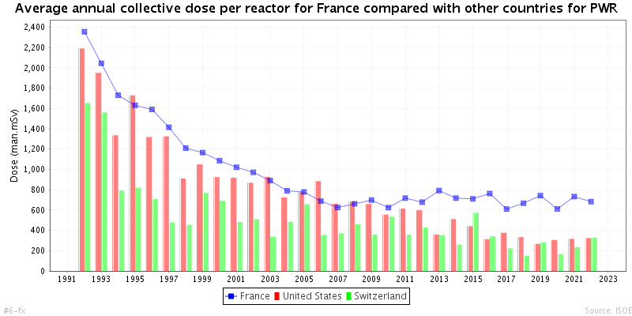
Country Dose Trends by Reactor Type (PWRs)
ISOE Objectives
Country X
ISOE Organisation
ISOE WG
ISOE Products
ISOE Website
Country X
Country Y
Country Z
ISOE Database

Slide 25
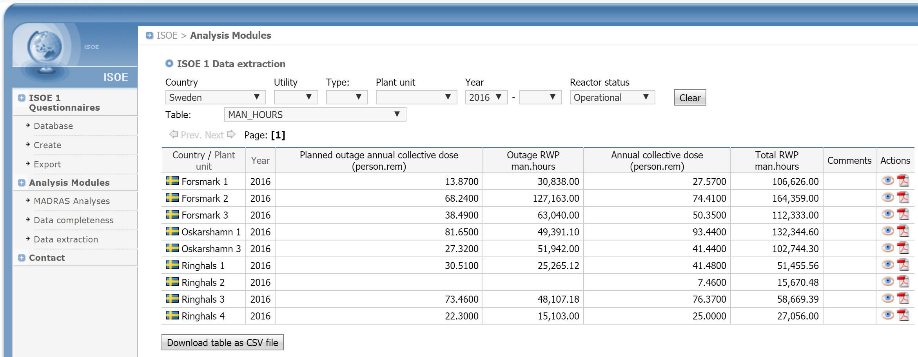
Data Extraction
ISOE Objectives
Possibility to extract any type of data of the ISOE Operational and Shutdown Questionnaires in order to perform your own analyses
ISOE Organisation
ISOE WG
ISOE Products
ISOE Website
ISOE Database

Slide 26
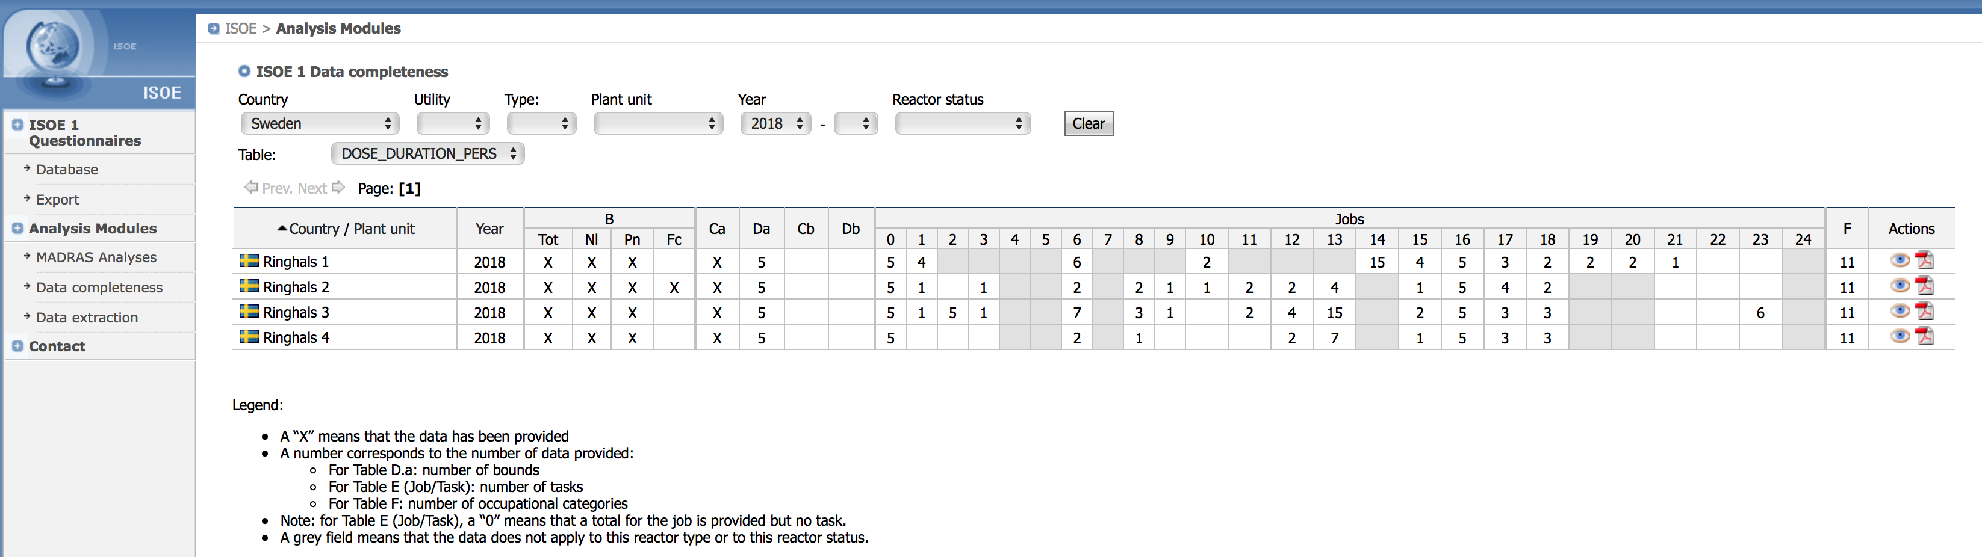
Data Completeness
ISOE Objectives
Possibility to have a view of the completeness of the ISOE Operational and Shutdown Questionnaires in order to select questionnaires to extract data available
ISOE Organisation
ISOE WG
ISOE Products
ISOE Website
ISOE Database

Slide 27

  Thank you for your attention!
  For more information:
www.isoe-network.net
ISOE Secretariat:
isoe.secretariat@oecd-nea.org

